Slide 1
Connected Lighting
Empowering Safe & Smart City
Philips Lighting
June 29, 2018

Slide 2
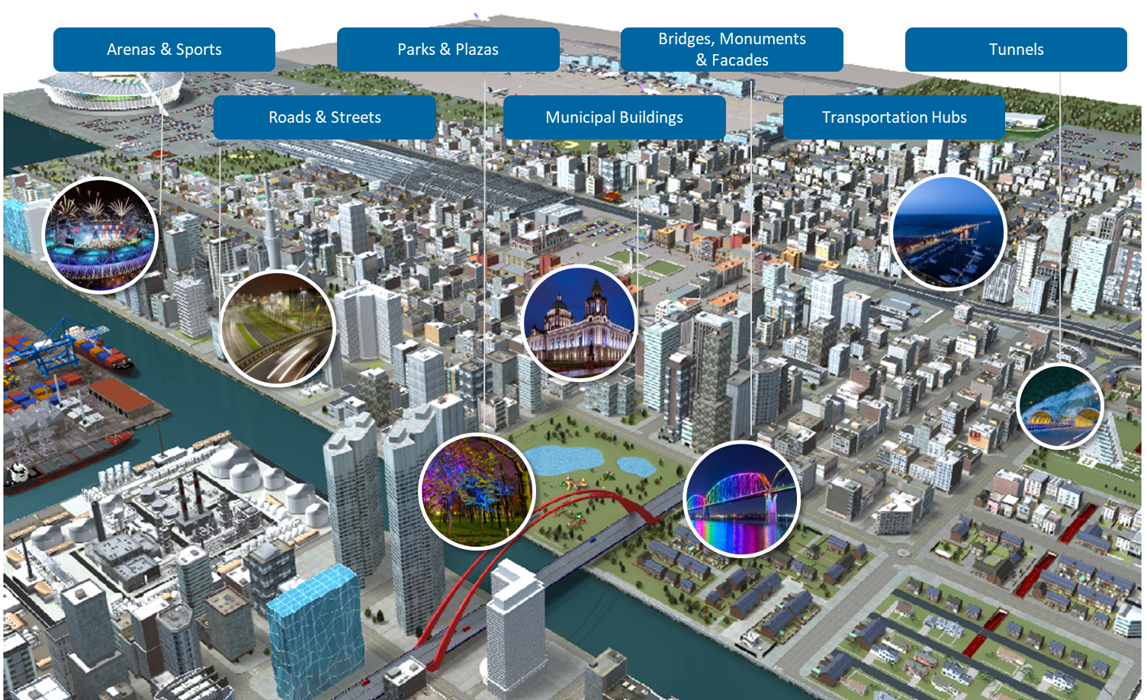
Public Lighting Enables Citizen Safety, Citizen Experience, City Livability

Slide 3


Citizens
Feel Safe
in the city
Less crime and a greater sense of safety
Livable cities
Unique city character
Event-specific lighting during festivals and events
Higher traffic safety
Attractive city image
Less light pollution
⁺10%
sense of security*
3
*Source: Municipal Street Lighting Consortium, City of L.A. (2012)

Slide 4
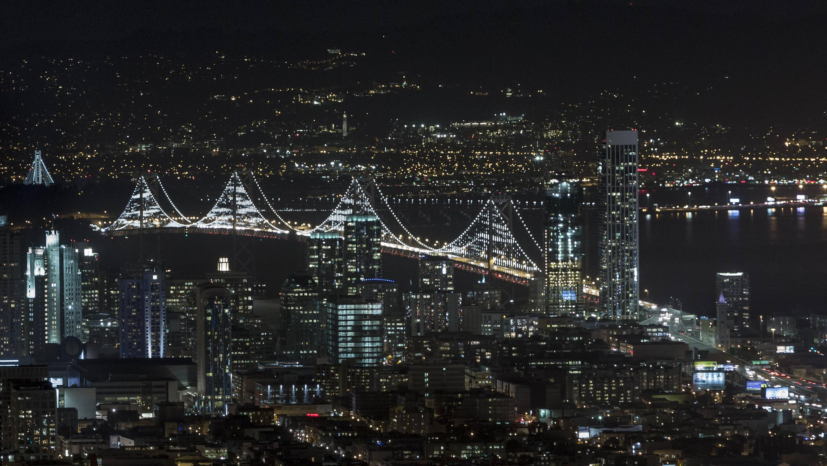
Public lighting: smart nodes
in a city-wide network infrastructure
Notes:
Through the lighting around us
70 billion light points by 2030
Sensor nodes in city-wide networks - improving quality of networks and systems
Can acquire data across city
Provide useful information..
Also, enhance cities: attracts tourism and boost local economies
Pic: temporary sculpture on Bay Bridge took cues from environment (traffic, wind, and water) non repetitive patterns turning the bridge into a giant sculpture.

Slide 5
Light-on-demand for citizens
Foster safer outdoor spaces at night
Increase energy savings up to 80% vs. conventional lighting
Reduce CO2 footprint with Solar Energy
Reduce light pollution
8

Slide 6
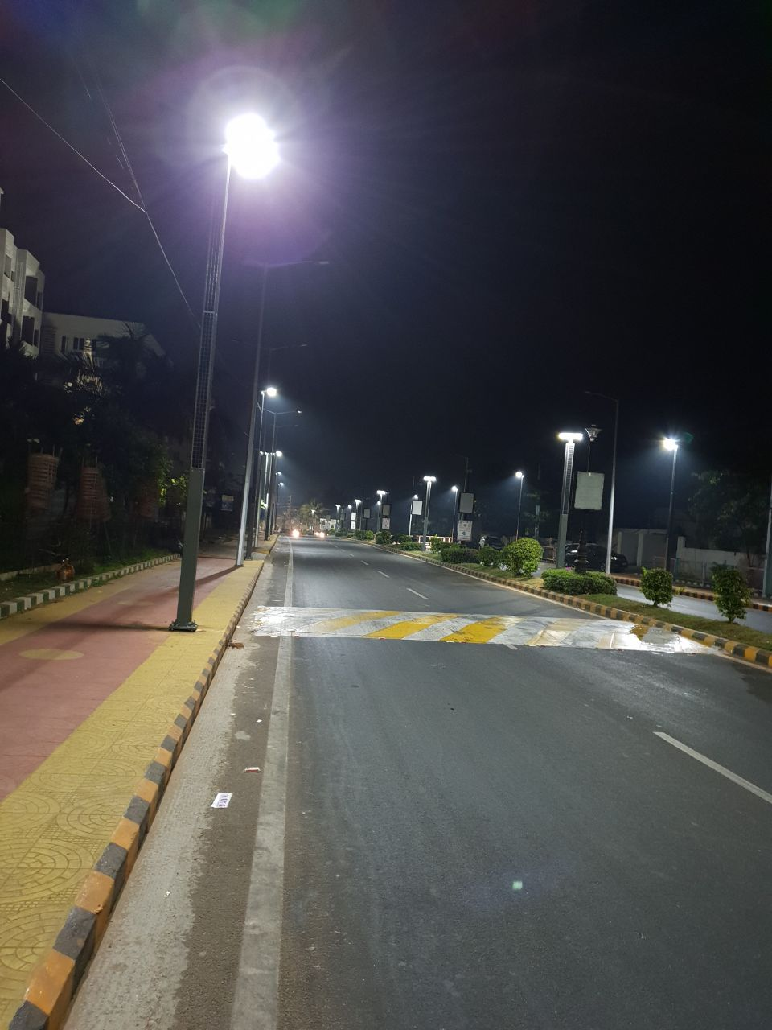
Light-on-demand for citizens
Foster safer outdoor spaces at night
Increase energy savings up to 80% vs. conventional lighting
Reduce CO2 footprint with Solar Energy
Reduce light pollution
8

Slide 7
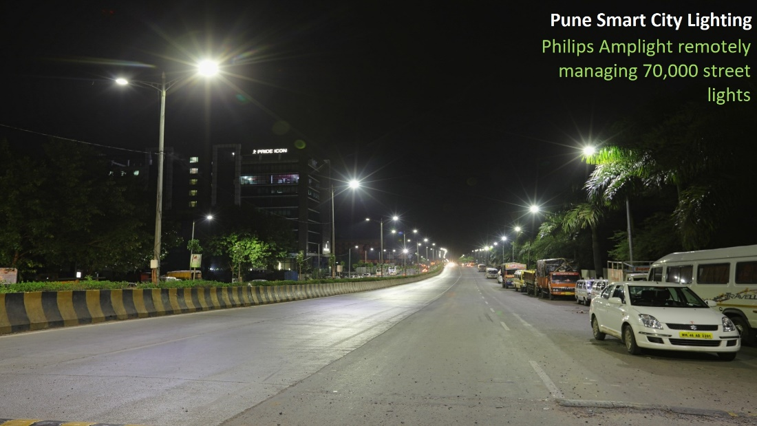
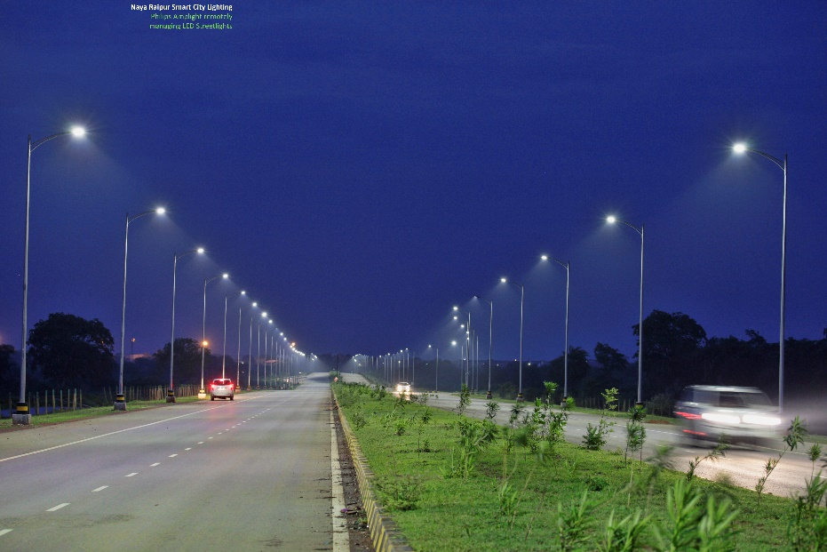
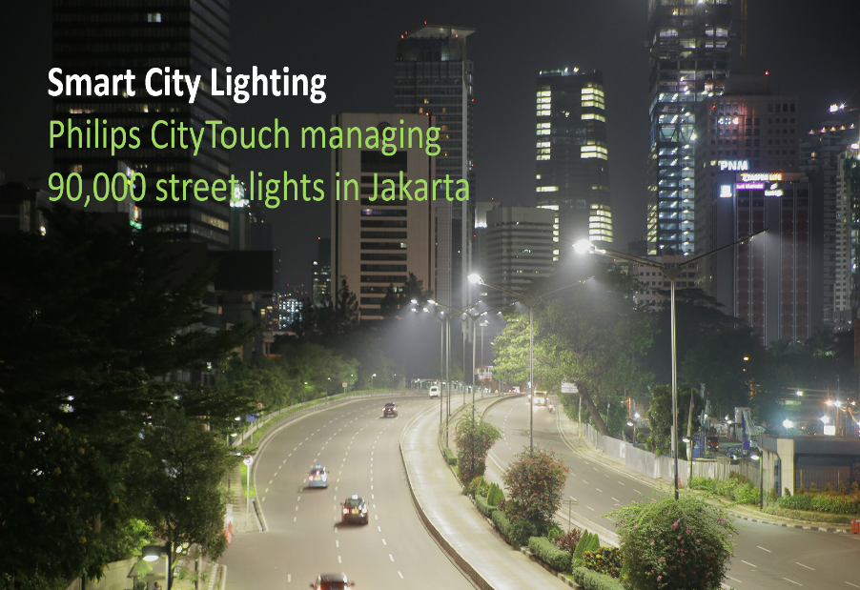
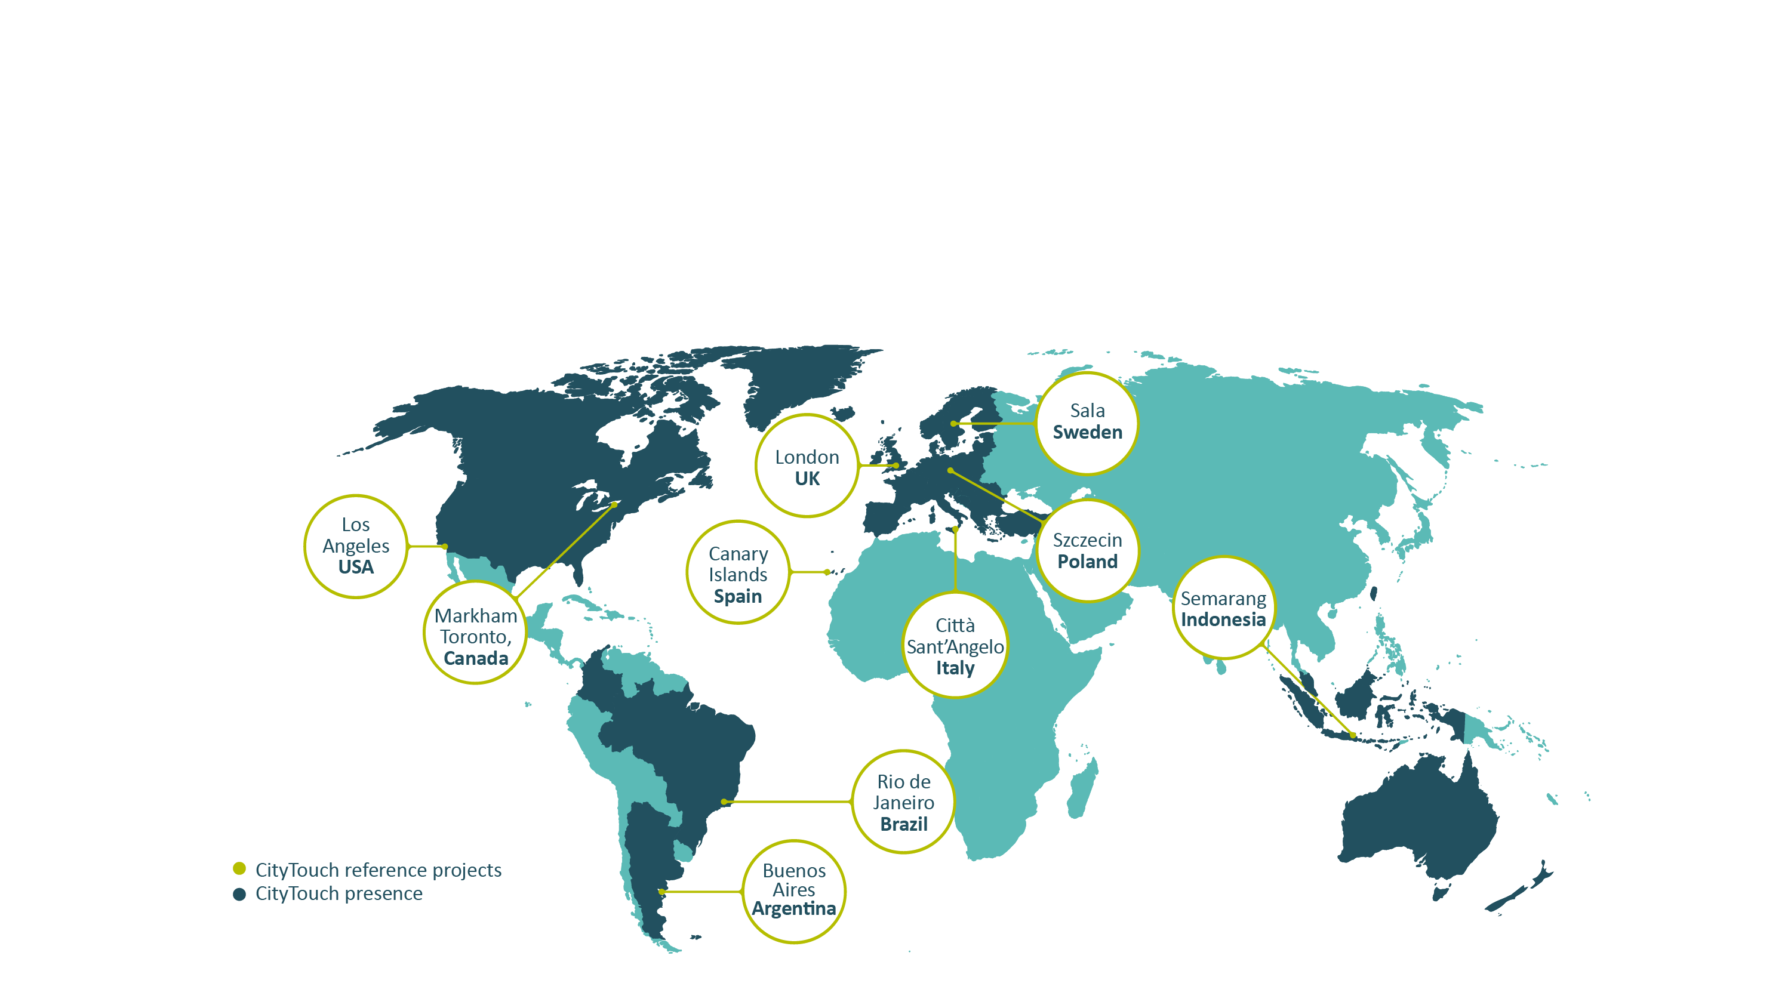
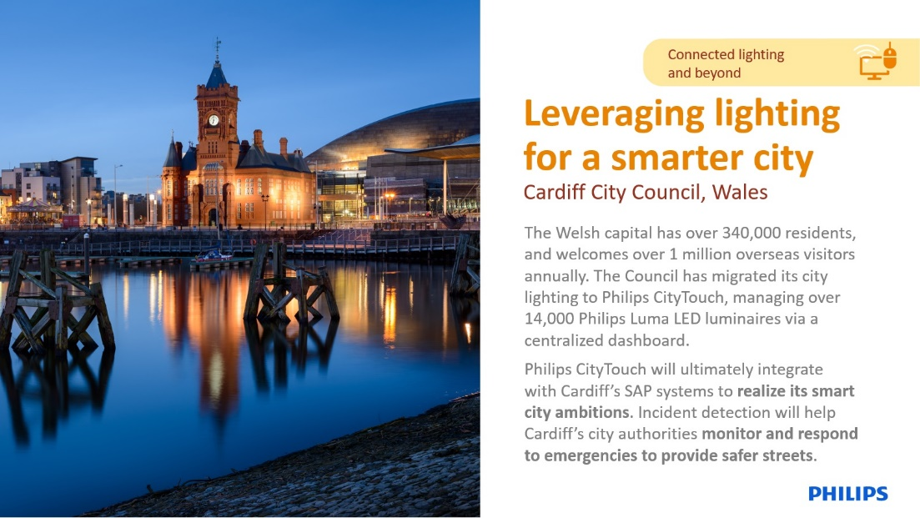
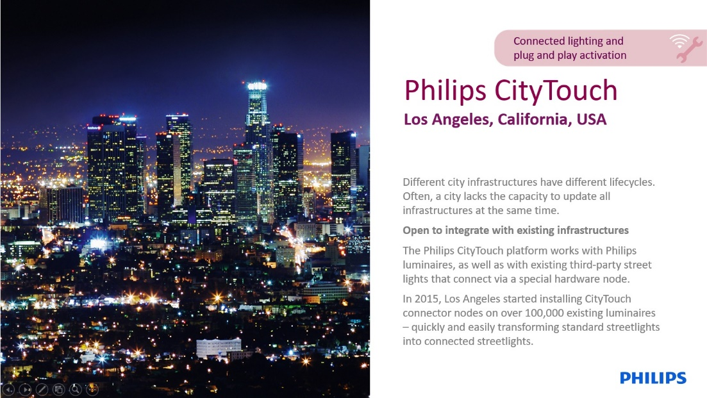
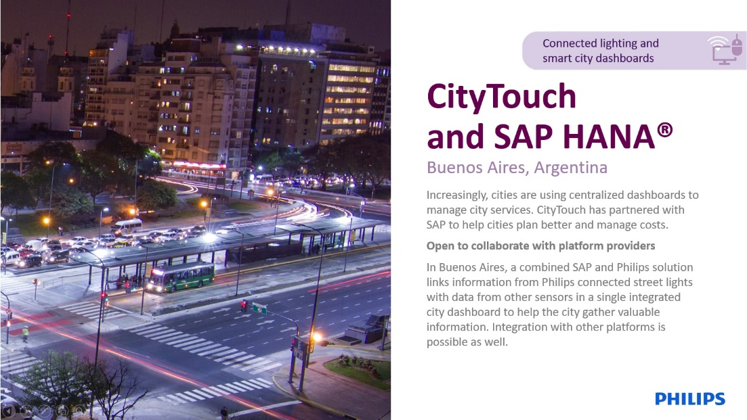
Future is here
Connected Streetlights are taking off
Today, about 2% of all our street lights around the world are connected. By 2025, we expect this number to grow to 35%.
1000+ Philips CityTouch street lighting projects in 31 countries. Largest Amplight Installation in Pune.
Notes:
-And you know, we’re really now reaching a breaking point that we think is significant as different local, and regional governments are understanding that taking advantage of connected operations is going to be essential for them to make the most of their infrastructure investments over the coming years.
In order to really get all of the efficiencies,
In order to link with their operational team,
In order to ensure the right kinds of job creation within their communities
-They really can take advantage of connected operations in order to create entirely new ways of getting their work done in a way that is effective for them and really meets their needs and requirements.

Slide 8

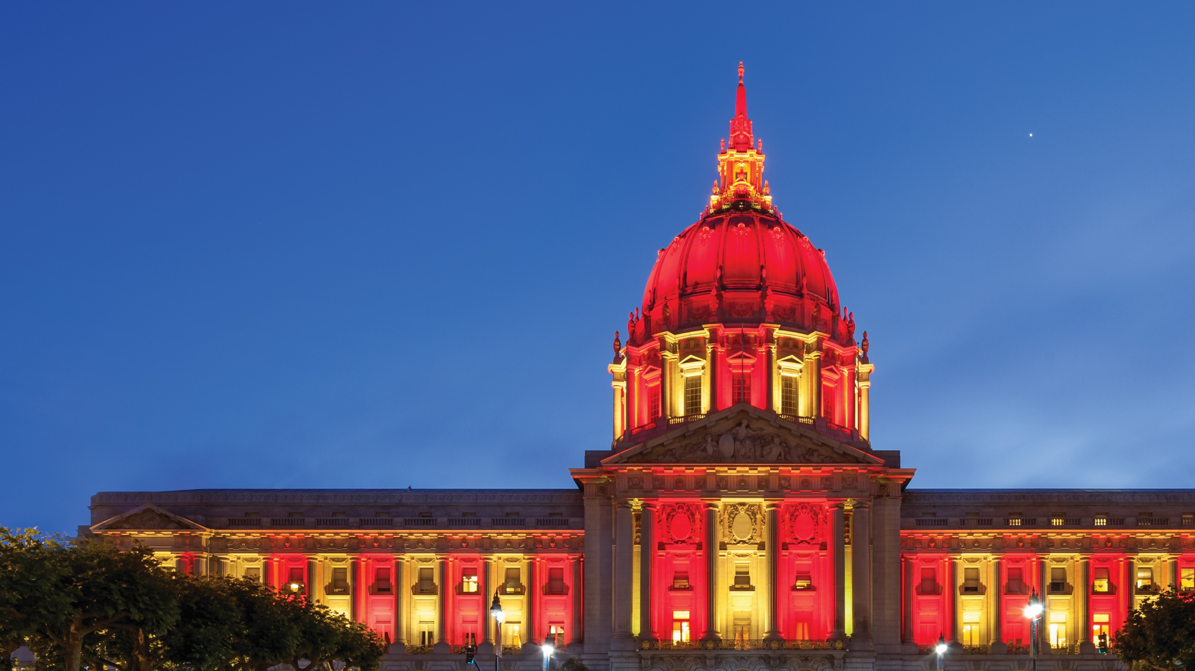

Enhancing Public Spaces

Slide 9






Enhance your open spaces
Transform the Central Markets, Parks, Plazas, Waterfronts, and other areas in your city
Create unique experiences for open spaces that are welcoming and safe
Efficiently commission
and manage your lighting infrastructure
Provide well-maintained spaces
Stay informed about the status of your lighting infrastructure
Give people peace of mind by fostering safe environments
Coordinate adaptive functional and dynamic lighting with city life
9
Enhancing city spaces

Slide 10
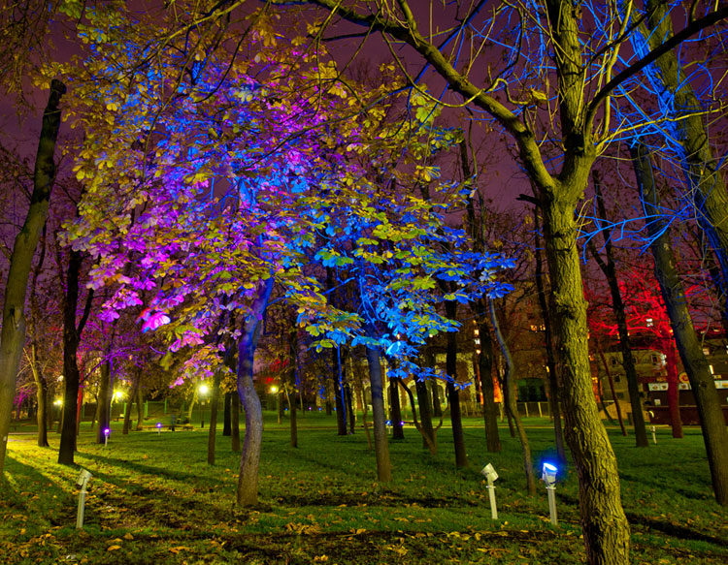
Enhancing open spaces
Create unique experience in open spaces
Schedule custom shows and content for particular times of the day, week or year
Enhance perception of safety
Keep energy consumption to a minimum
Create significant effect with limited intervention
Photo credit: Buzin Andrey
9

Slide 11
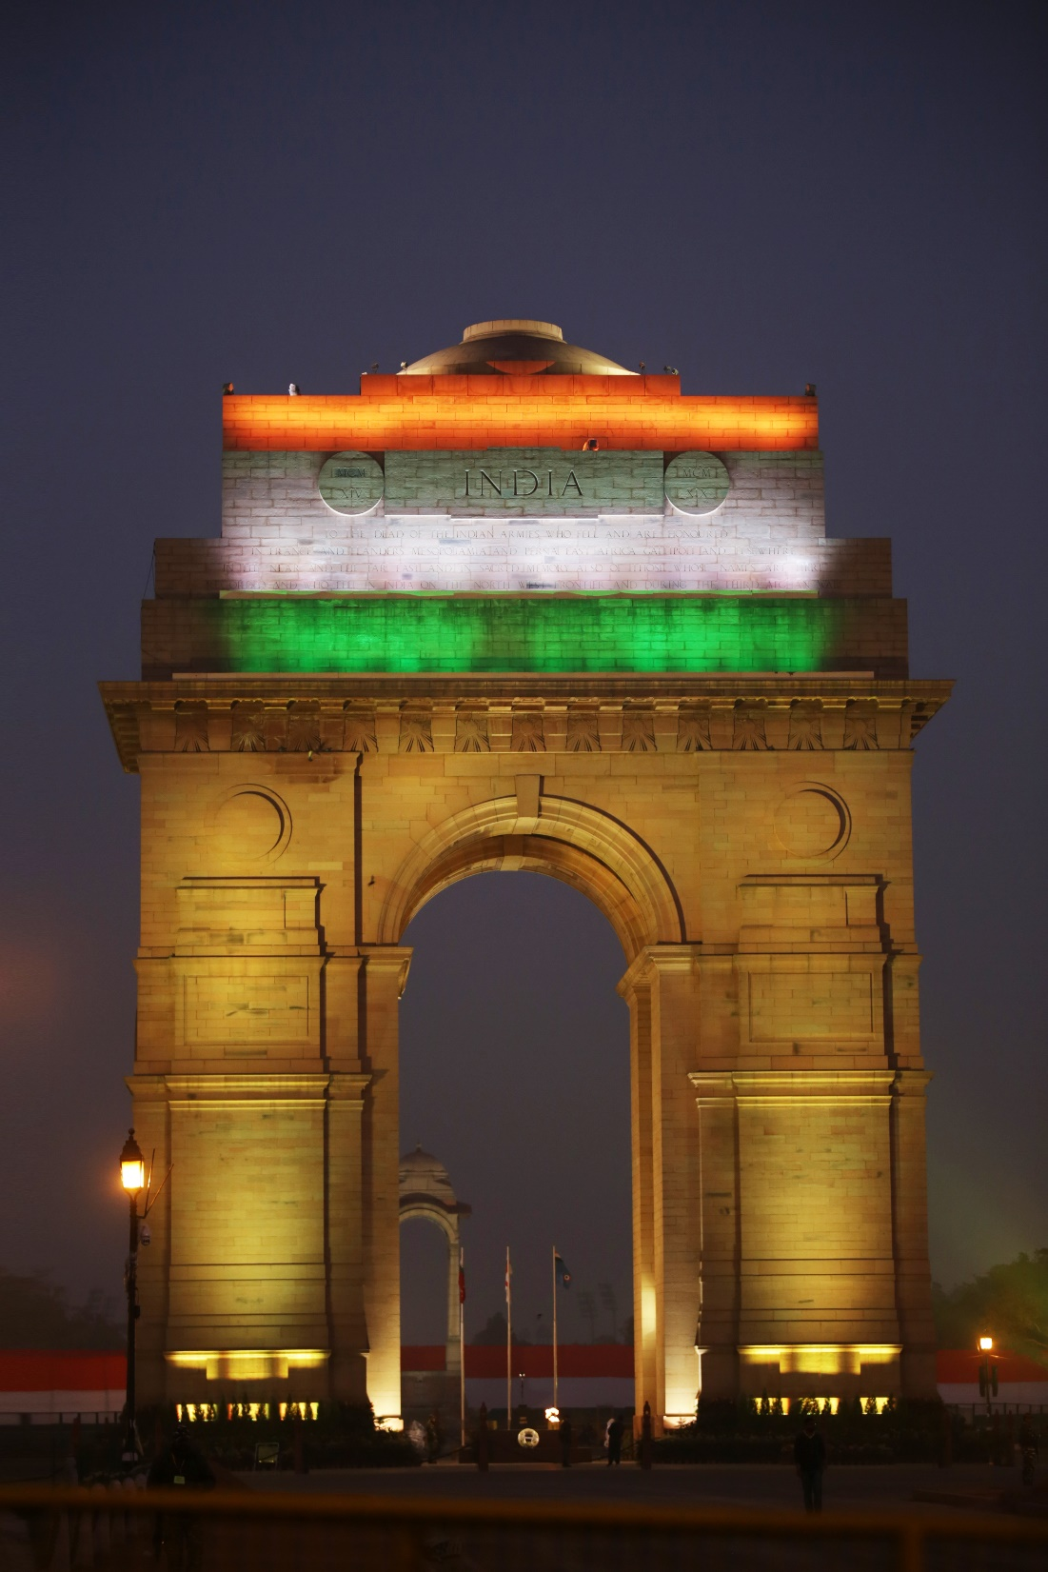
Inviting people to enjoy open spaces
Plug and play LED lighting systems
Energy saving
Diverse luminaire portfolio available for large-scale and small-scale effects
Create an inviting atmosphere simply by providing additional contrast in a setting
Complement other way finding and signage strategies for your site
Photo credit: Darius Kuzmickas
7

Slide 12

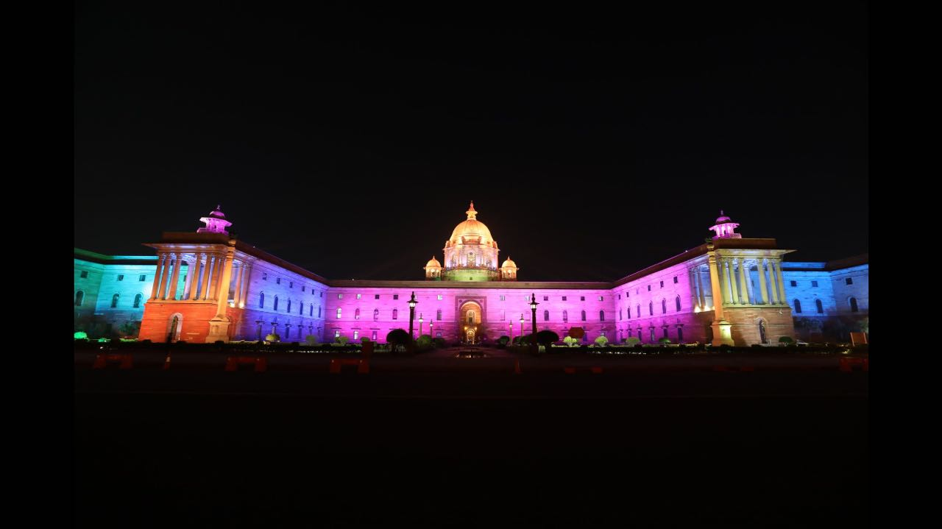
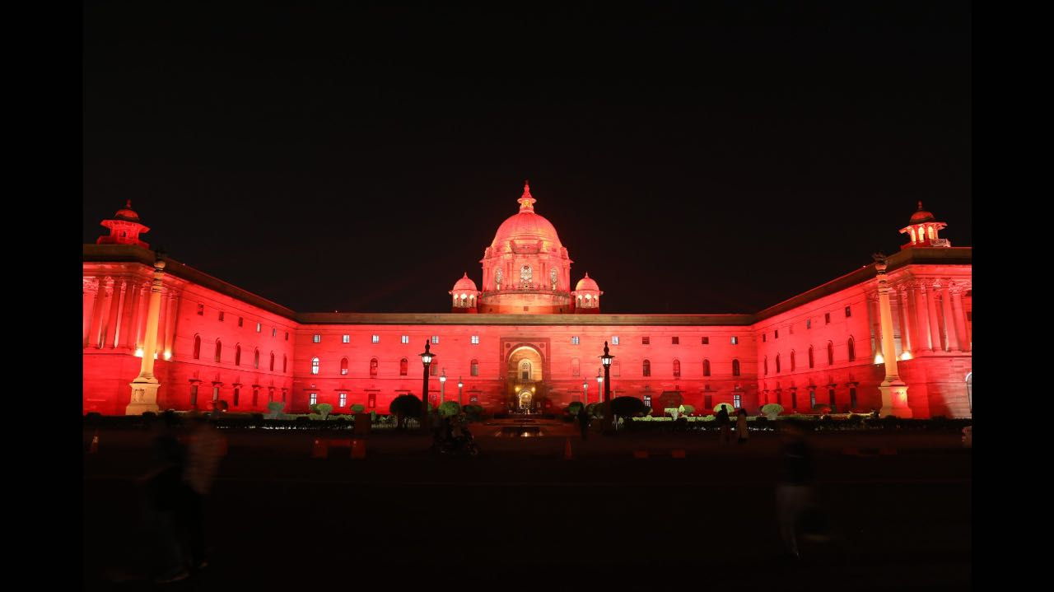
North Block & South Block, New Delhi
Notes:
The global economic crisis has put increasing financial pressure on cities.
At the same time urbanization is ongoing along with citizens’ expectation of a higher quality of life.
Managing growth with less money places heavy demands on budget allocation forcing cities to make hard decisions on investments.
Cities that strive for maximum efficiency at all levels, from lower energy consumption to smooth operational processes, not only realize immediate savings but also can significantly increase service quality.

Slide 13
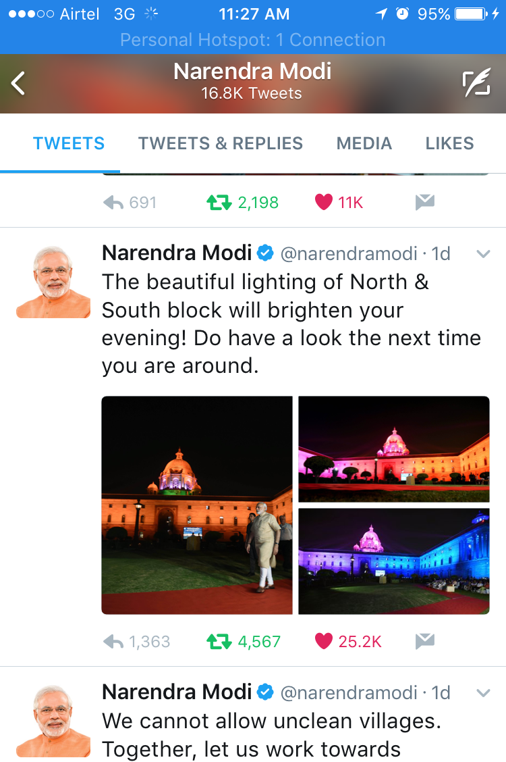
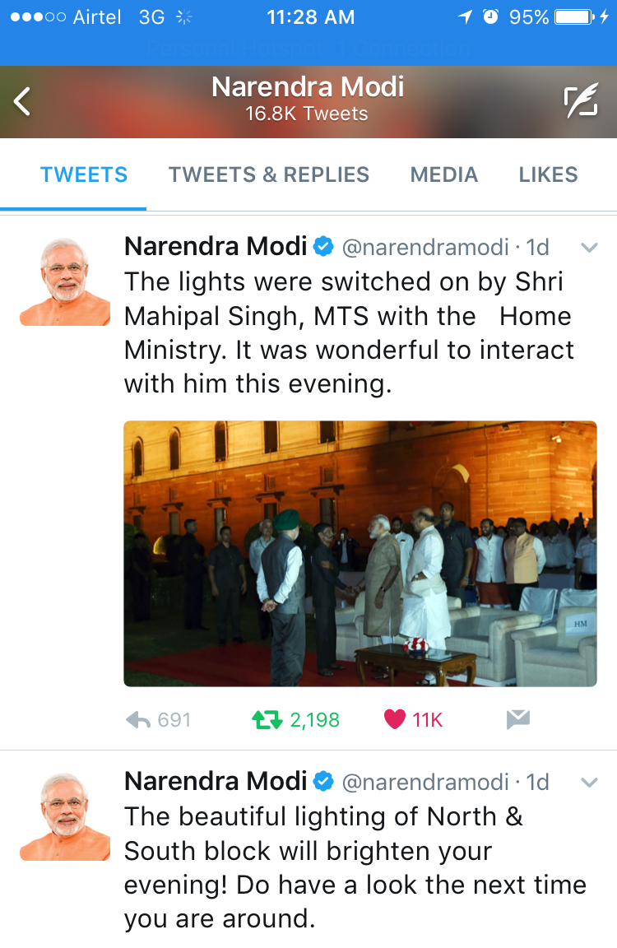
North Block & South Block, New Delhi
Notes:
The global economic crisis has put increasing financial pressure on cities.
At the same time urbanization is ongoing along with citizens’ expectation of a higher quality of life.
Managing growth with less money places heavy demands on budget allocation forcing cities to make hard decisions on investments.
Cities that strive for maximum efficiency at all levels, from lower energy consumption to smooth operational processes, not only realize immediate savings but also can significantly increase service quality.

Slide 14
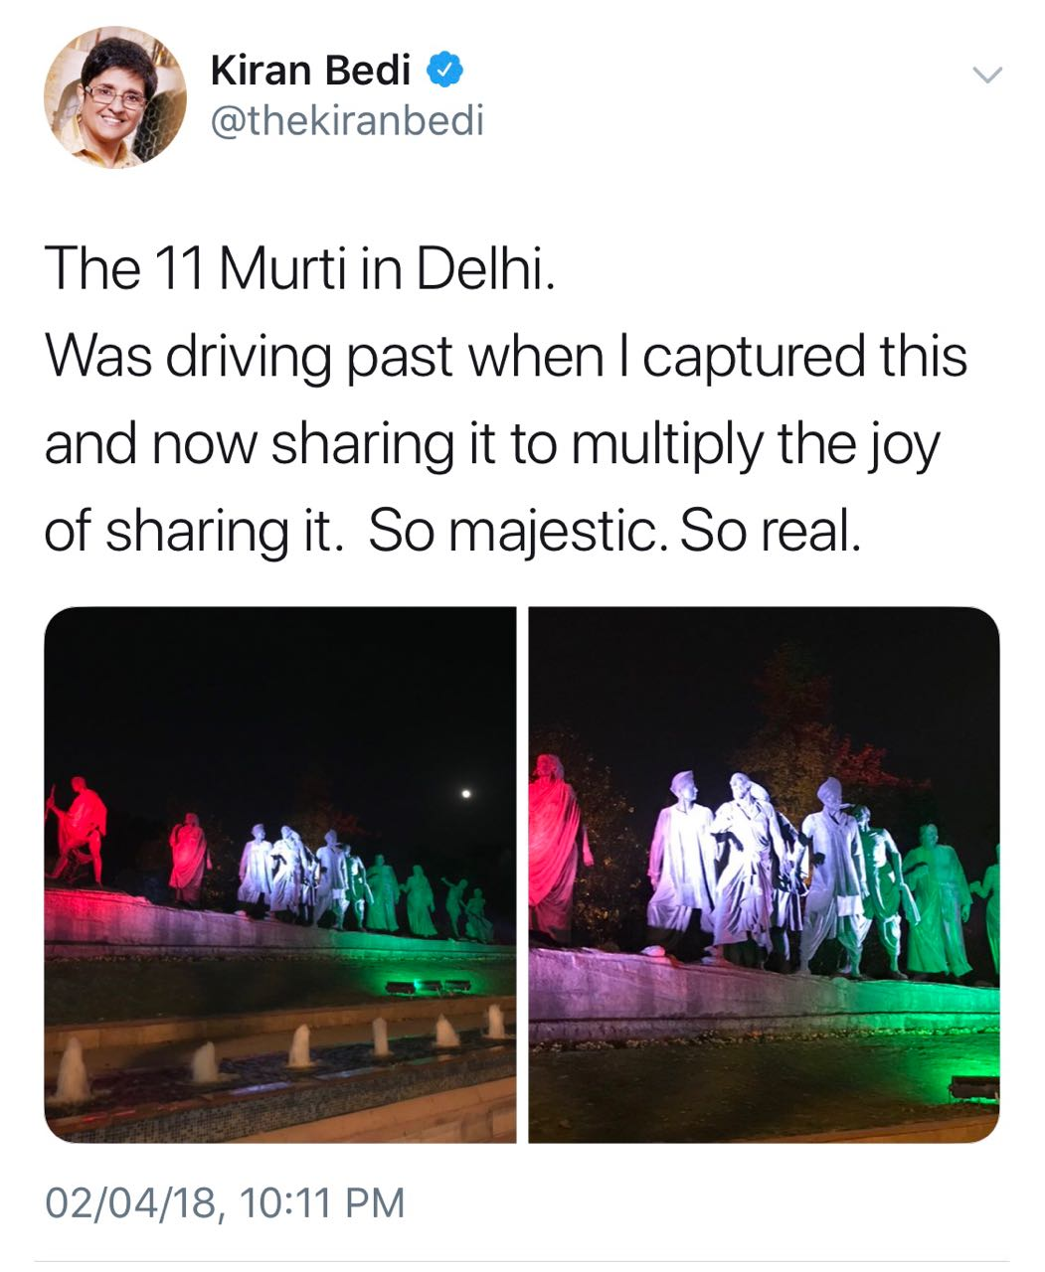
11 Murti New Delhi

Slide 15
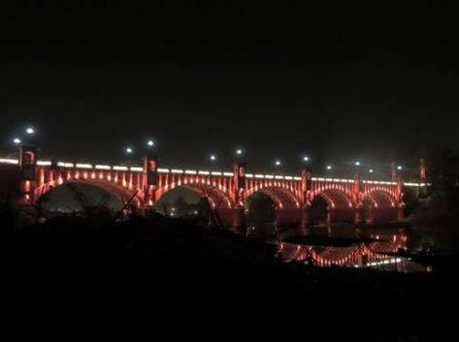
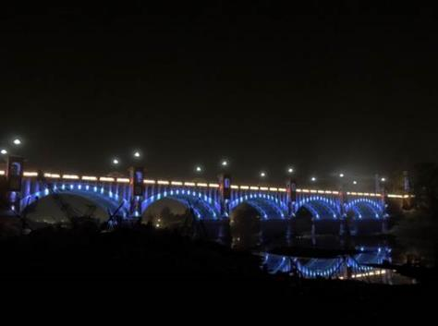
Lalpul Lucknow

Slide 16
Police Commissionerate Jaipur

Slide 17
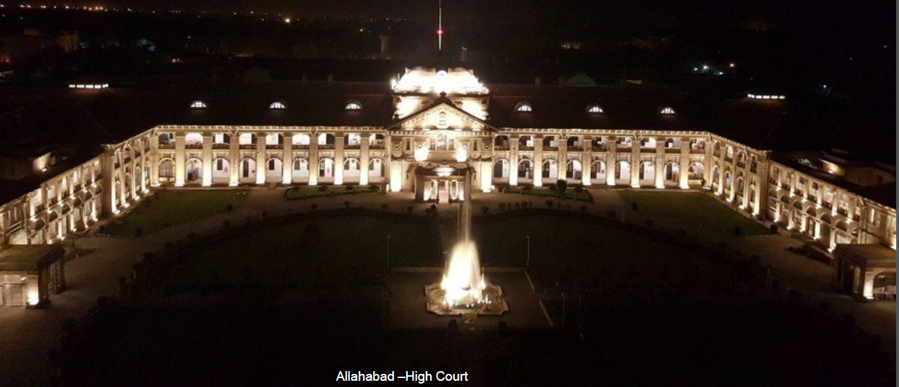
Allahabad High Court Allahabad

Slide 18
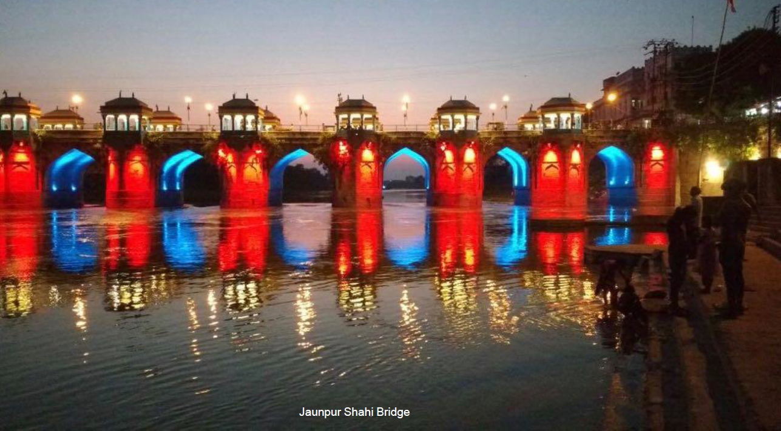
Shahi Bridge Jaunpur

Slide 19
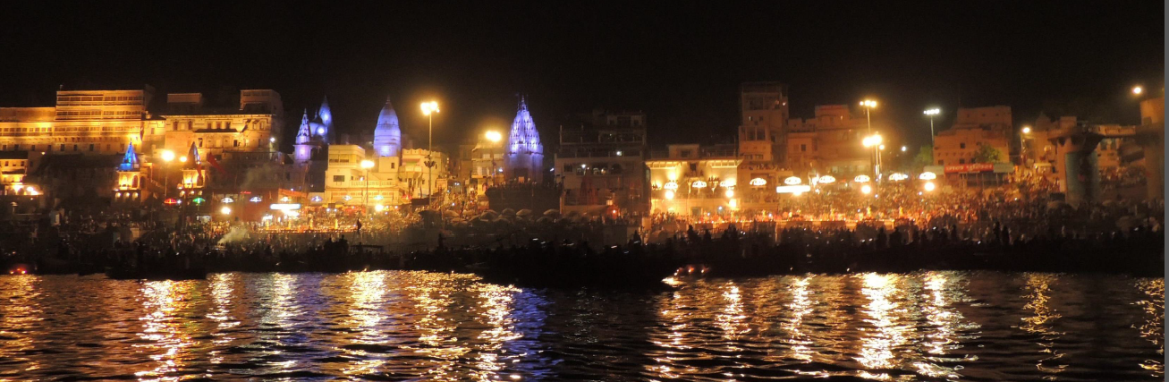
Dashshwamedh Ghat to Munshi Ghat Varanasi

Slide 20

Samne Ghat Bridge Varanasi

Slide 21

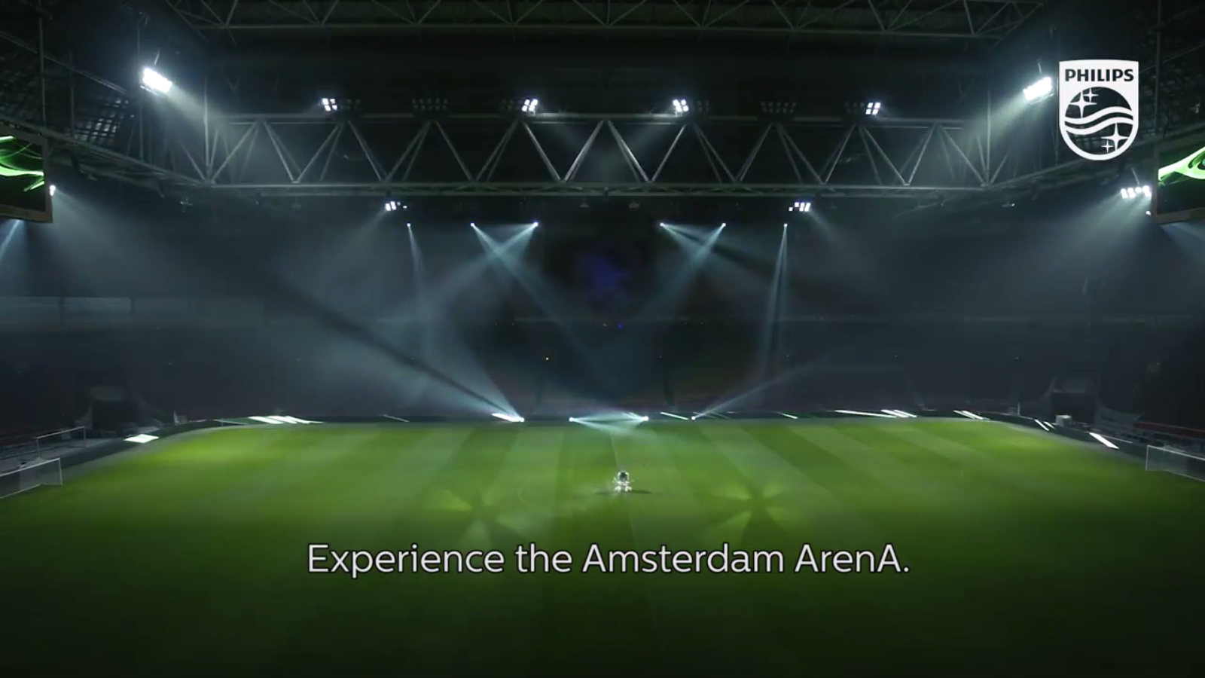
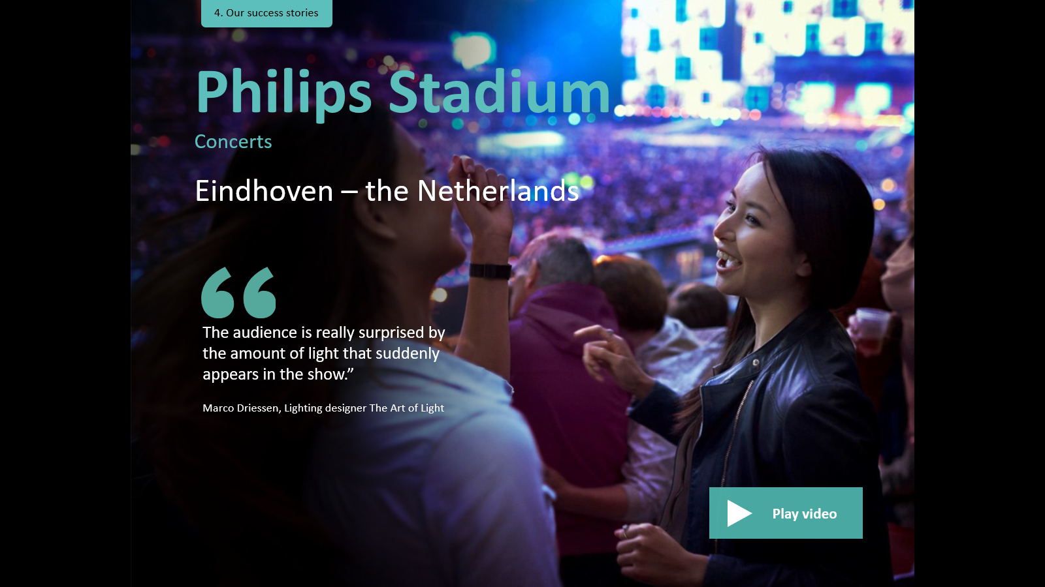
Connected lighting for arenas and stadia
Elevating the fans’
stadium experience
Amsterdam Arena & Many More
Fan experience.
The 100% LED-based stadium now delivers:
unprecedented synchronized experiences
full integration with different infrastructures like audio, screens, and billboards
immersive entry, event and exit experience
for fans

Slide 22
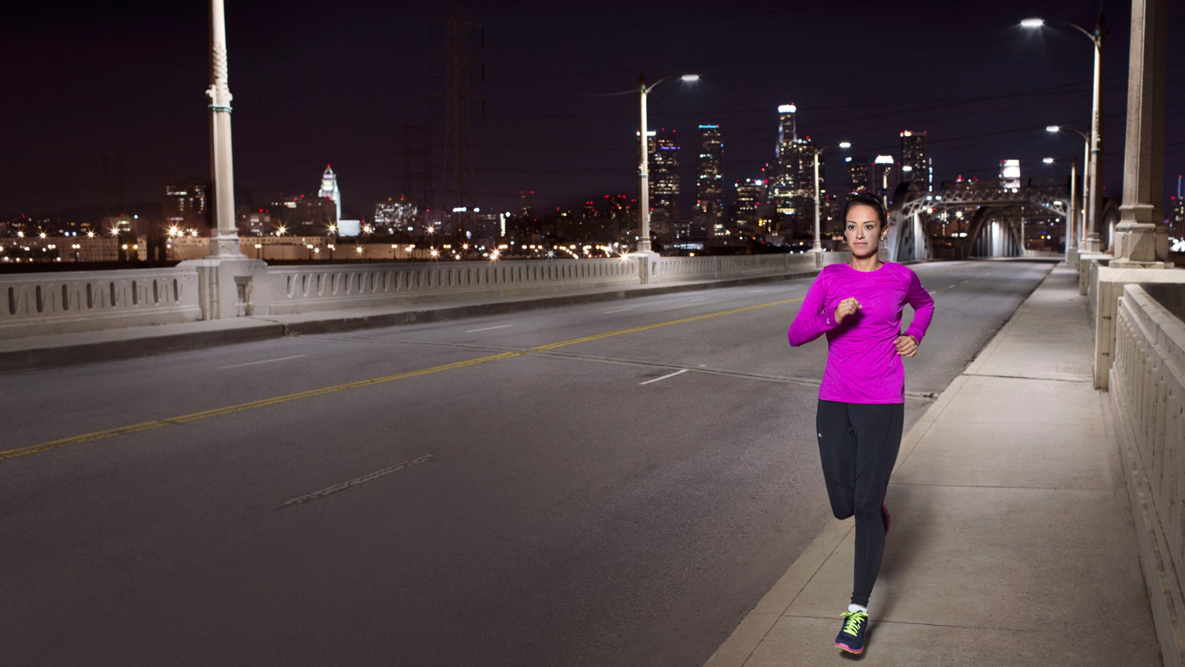

The right light
Ambient, dynamic,
responsive and interactive
Notes:
We understand city lighting:
Its role in Citizen Safety
And how to make it ambient, dynamic, responsive, and interactive.
And link it to connected backbones to benefit citizens and city managers

Slide 23

Connected operations
Convergence of lighting and information technologies to create new capabilities
Notes:
At forefront of connecting street lighting…
LA… huge retrofit project 110,00 third-party street lights made smart… Philips CityTouch wireless connector node…
Energy savings
Reduce maintenance costs
Public safety
Director of LA Street Lighting Bureau: “priceless because if we can save one life by finding and fixing a light that has gone out. We’ve done our jobs.”

Slide 24
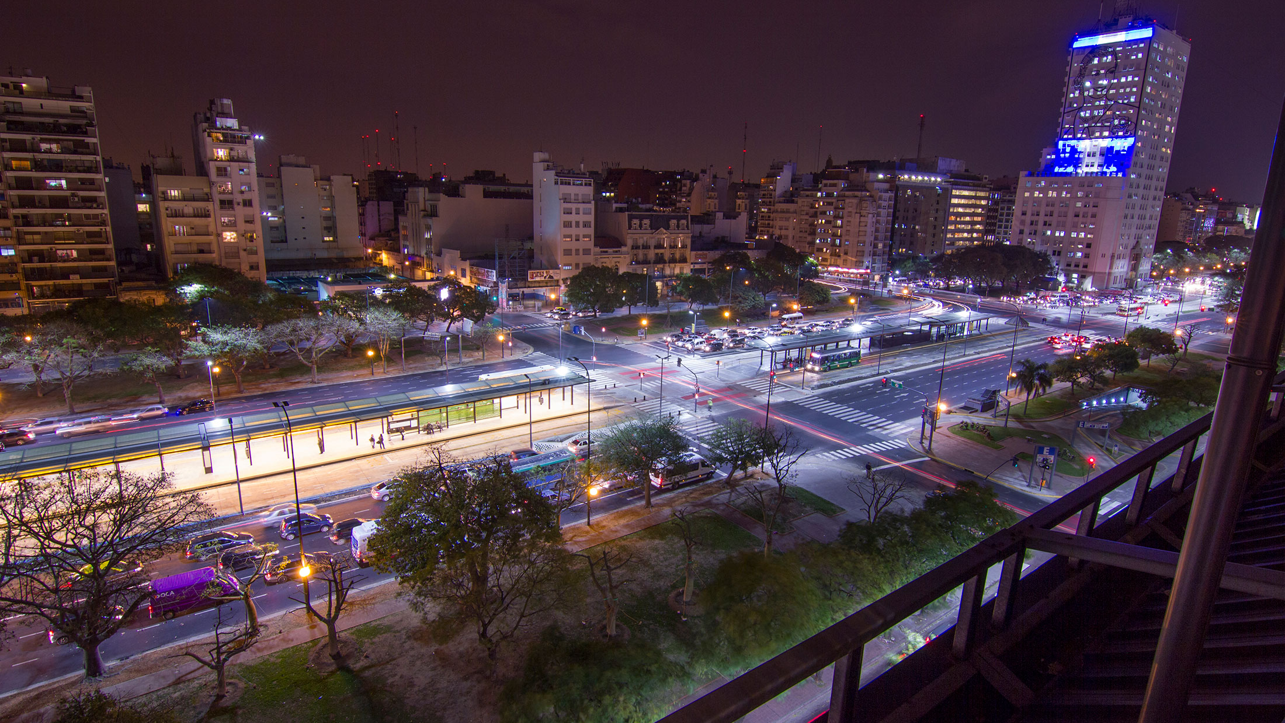
Evolving applications
Lighting integrated into a city’s technical ecosystem
Notes:
New applications and services
Buenos Aires… SAP Hana… real time information from 91,000 street in single city dashboard
360 degree view: Better planning, cost management. City safer
This is what we do already today - cities can embark on it NOW
By installing connected lighting infrastructure, you enable a smart city that can handle the challenges of 2030 and beyond

Slide 25

Keeping systems safe and secure
by leveraging the cloud
Data
privacy
Authentication
Encryption
Intrusion
detection
Advanced
security
Source: Machina Research, Future-proofing IT for Smart City services, 2016
Notes:
-Pursuing an open approach heightens the importance of data protection and security.
-Once you start linking the major systems of your Smart City together, security is of the utmost importance – and it is essential that the “links” between all of the systems be secure.
-Our white paper “The Smart City is Open” that Philips partnered with Machina Research to produce, talks about the main security requirements of an open system in detail. I won’t go into all of the details but security requirements of an open system can be summarized as follows:
Dedicated user roles, so that users are assigned different levels of access depending on authorization.
Strong passwords and two-factor authentication, enforcing the use of strong passwords for login.
Forward secrecy, so that today’s data transmissions also stay confidential in the future.
Full encryption of all data throughout the system
Tamper-proofing, so that only authorized and registered devices can communicate with the system.
Input validation, on the basis of pre-defined data types, avoiding input of wrong data formats (for example, numbers, string fields, etc.).
Secure communications, so that there is proper authentication and integrity while making efficient use of data traffic. There should be strict firewall rules between the communication device and central server in place, and filters should include port, protocol, source IP and destination IP.

Slide 26
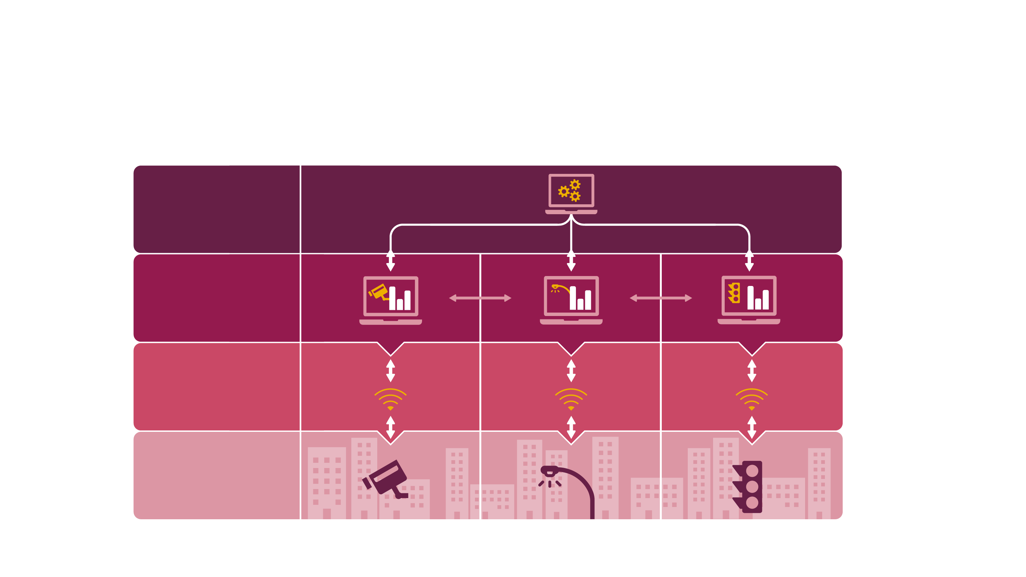
We foster openness
on all levels
City asset management
/dashboard
Software level
Network level
Asset level
Vision – Empowered cities with connected lighting
Location: TBC
Notes:
-But that doesn’t mean that over time there isn’t an opportunity to expand and connect across different service layers or different service verticals.
-So if you think about street lighting as a service here and think about situations where there might be reason for public safety factors to change light levels, there would be a reason to share information between these two analytical layers.
-There may be situations when it’s important to share high level energy statistics with broader city dashboards that are trying to track overall city energy savings.
-So there are many examples of how and where and on what level it is important to connect and be open.
-I think that this is a reflective of that evolutionary model of the smart city, where you actually are able to, over time, create something that is powerful and meaningful for your city.

