Slide 1
How can smart cities become smart health cities
29th June, 2018

Slide 2
Components of a smart health city
Unique health records for all citizens with longitudinal medical history
An integrated network of HMIS, EHR, Telemedicine, Care AI, analytics to support the continuum of care
Real time health and wellness monitoring through health dashboards based on intelligent connected solutions
Interoperability policies and standards for public health data exchange and data security
Population health analytics used by authorities for planning health care programs, resources

Slide 4
Roadmap to a smart health city
Operational readiness
Operational analytics
MIS reporting
My health center
Integrated care command center
Integrated disease surveillance
Diagnostics
Consultation
Vaccinations
Drug dispensing
Care helpline
Mental health counselling
Case management (Maternal, child care etc.)
Trend analysis
Risk factors identification
Communicable disease analytics
Operational analytics
Telemedicine 2.0
Online and offline consultations
Integrated medical devices
Integrated video conferencing
Remote monitoring
Population health analytics
Population health status analysis
Health indicators analysis
Incidence forecasting
3-6 months
9-12 months
mHealth apps patient
6-9 months
Care provider networks
12-15 months
Appointment scheduling
Health services information
Personal health records
Pharmacy network
Diagnostic lab network
Blood bank network
mHealth apps provider
Payment gateway integration
Calendar management
Referral management
Disaster alerts
Integrated credit/debit/net banking/UPI
Jan-Dhan account integration
Automated benefit transfer
HMIS
Record digitization
EHR integration
Telemedicine integration
Care AI
EHR
Artificial intelligence chatbot
Symptom checker and provisional diagnosis tool with clinical protocols
Triage and smart routing
Longitudinal view of shareable health records
Practice management access to individual clinics
Health card
Biometric / Aadhaar linked
Universal patient identifier

Slide 5
Making health care simpler and work better for everyone
Patient
Provider
Personalized care plans
Significantly improved velocity of care
Continuous access to connected care
Secure and shareable personal health records
Call and interactive SMS access from feature phones
One stop shop for wellness and simple to complex care
Seamless referral systems
Reduction of medication errors
Longitudinal electronic medical records for each patient
Improved care management quality
Reduced load for specialists as appropriate cases are routed to primary physicians on time
Patient
Provider
Government
Outreach programs
Centralized repository for all health Information
“Always-on” access to care, even in remote settings
Integrated surveillance and prediction of disease burden
Optimal allocation and utilization of resources
Operational and disease metrics to frame public health policy
Sophisticated triage deflects load from secondary and tertiary settings
Personalized health screens based on likelihood of disease
Valuable source of field data for public health policy
Analytics driven cohorts for targeted outreach and interventions
Optimal vaccine delivery and awareness camps

Slide 6
Optum: A UnitedHealth Group company
Ranked 5th of the Fortune 500
$201.2B FY17 revenue
A health services and innovation company
$91.2B FY17 revenue
OUR MISSION
Helping people live healthier lives and helping make the health system work better for everyone
124 million
100 thousand+
$3.3 billion+
150 thousand +
empowered individuals
health care facilities served
Annual investment in technology
Healthcare experts globally
PPP Model
Private: Capex; Government: Annuity based contracts
As of Q1 2018.

Slide 7
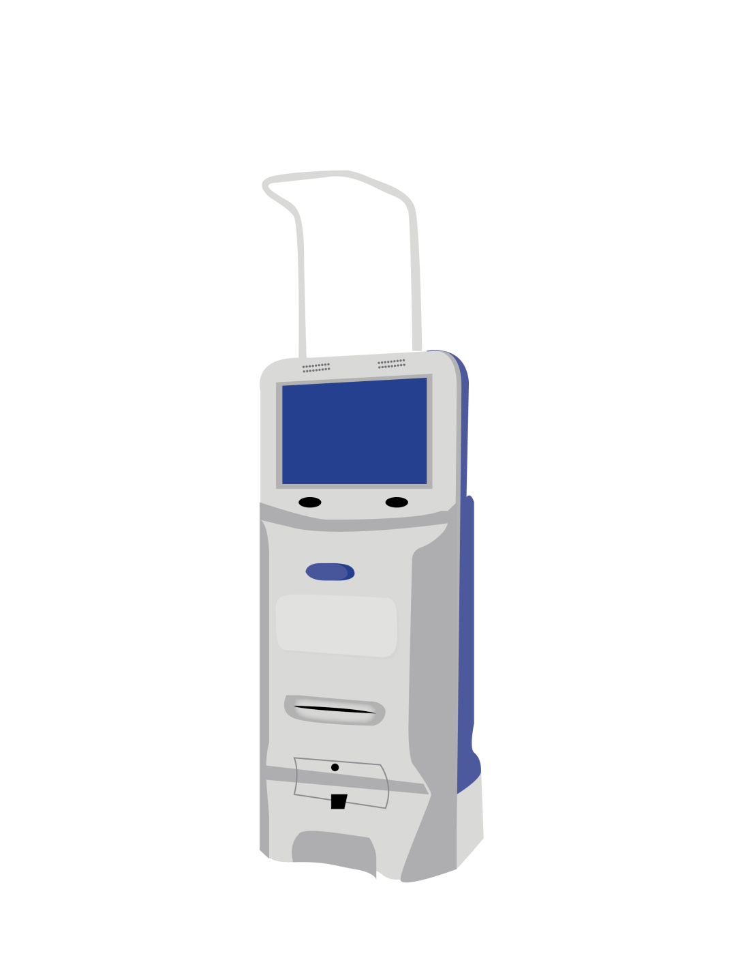
Thank you.
Health ATM
My Health Center
Hema Jagota
Director & Head – Marketing, Optum (A UnitedHealth Group Company), E: hema_jagota@optum.com

Slide 8
Working across the health care continuum
PROVIDERS
EMPLOYERS
HEALTH PLANS
4/5
4/5
~300
CONSUMERS
U.S. hospitals
of Fortune 100
health plans
LIFE SCIENCES
GOVERNMENTS
124 million
empowered individuals
100+
38
organizations around the globe
States and DC served for federal services
As of Q1 2018.

Slide 9
Optum in India
Operating in India since 2006
Employs over 22,700 Healthcare Professionals
Across 5 cities: Gurgaon, Noida, Hyderabad, Bangalore, Panchkula
Broad and deep experience in health care
Health care technologists: Information security, Information integration, IoT, mHealth, Blockchain
Health care data scientists: Staticians, economists and population health experts
MBBs & process experts
Surgeons & doctors
Nurses, pharmacists, medical coders
26% CAGR (one of the fastest growing health care IT services companies in India)

Slide 10
Powering intelligence across the health care system
Current challenges
Our solutions
Access
Integrated health management solution
Efficacy
Health and wellness center
Efficiency
Smart healthy city
Affordability
Telemedicine
Reactive
Population health analytics
Leveraging global public health expertise to improve affordability, accessibility and efficiency of care in India

Slide 11
A comprehensive & patient-centric approach to health care

Slide 12
Integrating stakeholders through a robust technology backbone
Patient
Government
Propensity models for cohort identification
Stimulus response modeling of interventions
Intelligent resource allocation
Intelligent scripts based on AI & protocols for rapid triage
First contact is always available
Can handle references, scheduling, prescription refills etc.
Government /PSU
Patient
Call/SMS/chat
Digital health data
Care AI and
Population Health Analytics
Telemedicine 2.0
Electronic Health
Records
HMIS
Frontline health workers empowered by tablet based mHealth apps
Conduct health surveys and health awareness programs at the grass root level
Care at home with telehealth kits
Tablet/smartphone based interface
Physical visit to MHC/PHC, when required
Care at home, as clinically necessary
Comprehensive medical history
Propensity of disease and comorbidity tags
Personalized care plans informed by AI and clinical protocols
Digital health data
Health monitoring
Health data collection
Teleconsults and follow-ups
Scheduling, care plans, e-prescriptions, lab orders
Health and wellness apps
mHealth app
Provider
Outreach
programs
Provider
Outreach programs

Slide 13
Enabling care anywhere
Feature phone (call/SMS),
Smart phone (mHealth apps,
portals, e-mail), kiosk, assisted by health worker (pre-primary),
my health center, clinics, hospitals
triage with AI and protocols
Patient
Layers of care
Home, offices, bus stands, train stations, airports, apartment complexes, citizen service centers (e-seva), places of worship, accident areas
Trained health workers, pharmacists/RMPs, MBBS doctors, remote GPs and specialists, in-person visits (PHCs and clinics, small hospitals/CHCs/specialty centers, large hospitals)
Digital health data
Electronic health records, patient and family medical history, labs and imaging results, prescriptions and Rx history, personalized care plans, next best action models, physician briefs and notes

